Slide 1


Slide 2

What is
Media and entertainment company for super fans CHANNELS
Video Entertainment Culture
Tech Science
We know the future of TV looks nothing like the past. Great TV won’t be made for mass audiences. It’ll be made for the right audiences,
using data both to inspire creativity and connect shows with influential viewers,” said Pete Cashmore, Founder and CEO of Mashable. “It won’t happen on the big screen. It’ll happen on the screen
you have in your pocket -- the mobile phone. The future of video is on the handset, not the TV set.”

Slide 3
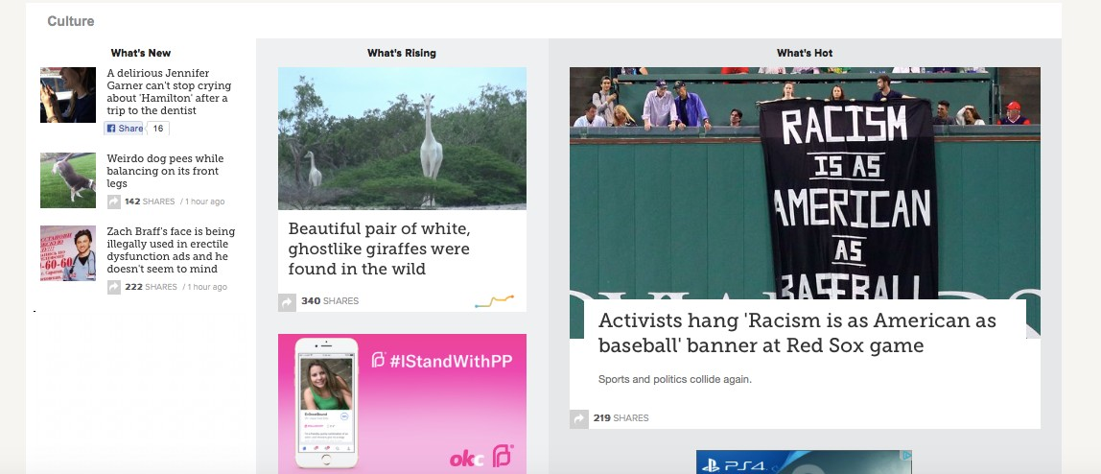
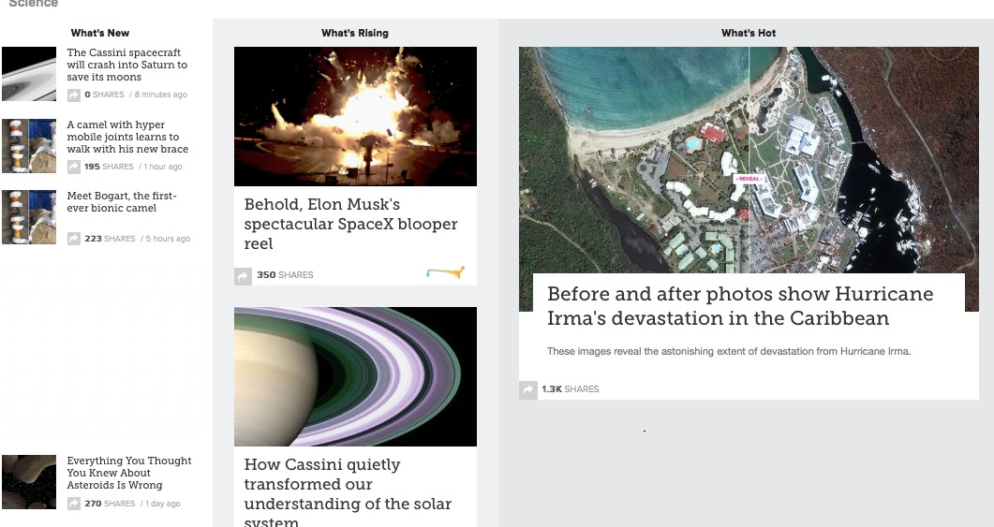
Video
Culture
Entretenimiento

Slide 4
What is the goal?
PREDICTING THE POPULARITY OF ONLINE NEWS
Based on number of social shares of articles

Slide 5
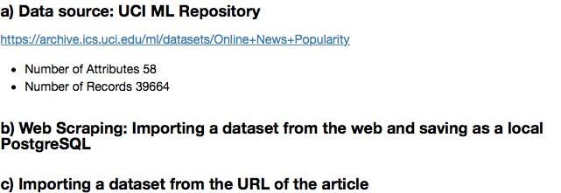
Dataset Description

Slide 6
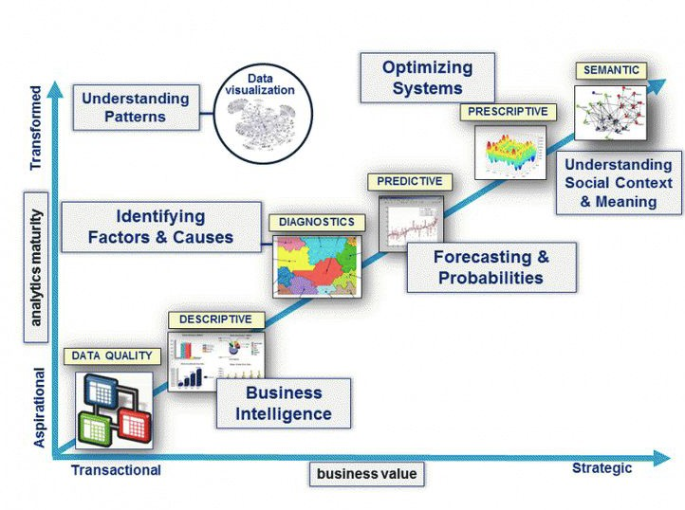
Data Analysis
NLP
Understanding URL content

Slide 7
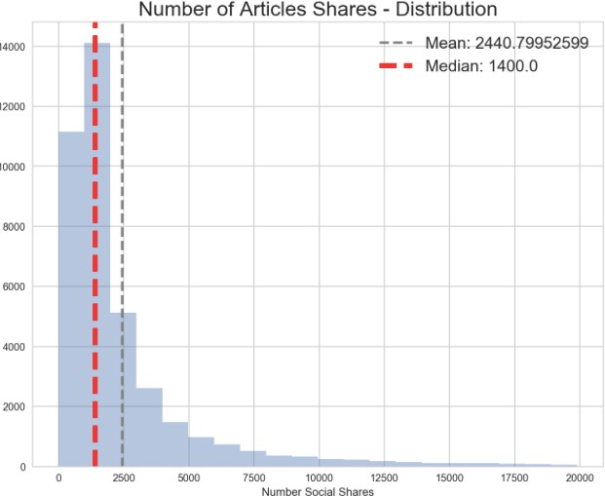
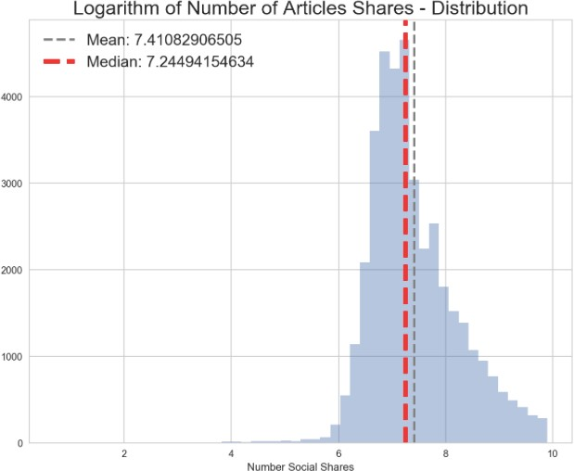
Target

Slide 8
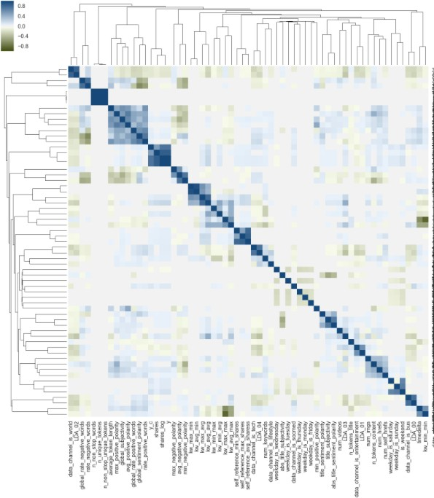
Corr1e.3l.Faeatuituorenenginering
Strong correlated features corresponding to the same topics

Slide 9
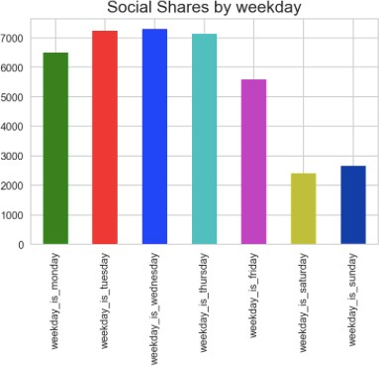
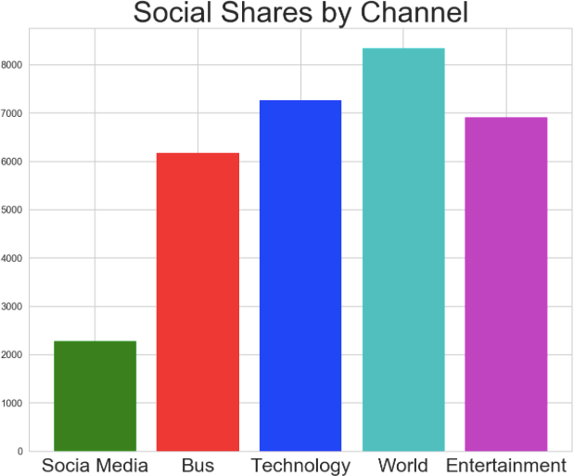
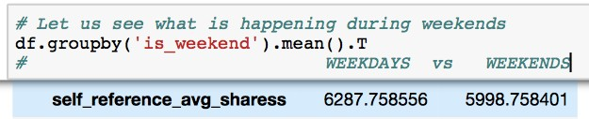
News in World and Technology of most popular and more shared during the middle of the week

Slide 10
Caveats and limitations in the data set
There is no information about the relationship between the number of times an article is shared vs the amount time the article was online
There is no information on how the channels cross over
Criterion to self referenced articles in Mashable
Limited information about natural language processing features

Slide 11
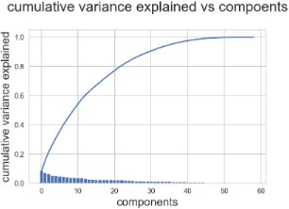
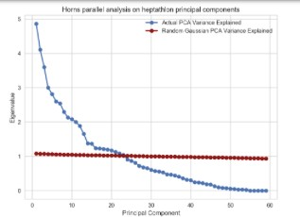

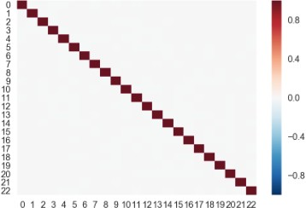

Almost 80% of the explained variance can be explained by just 23 of the principal components
Dimensionality reduction
Horns parallel analysis on heptathlon principal components
Clustering Analysis
Number Cluster = 3
K-Means
Hierchical clustering

Slide 12
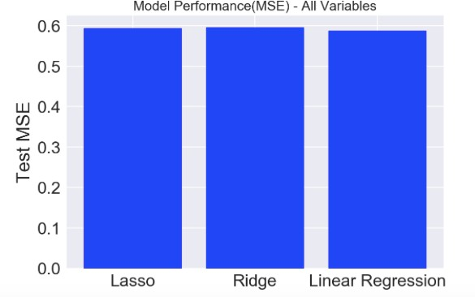
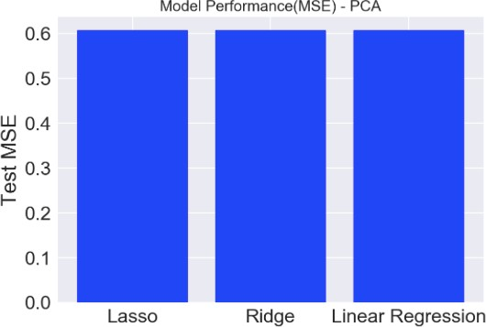
Linear Regression
All Variables
PCA

Slide 13
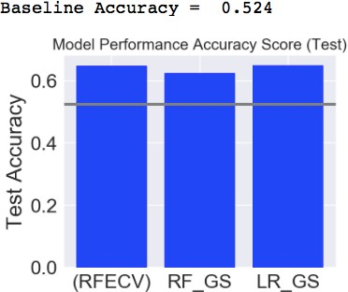
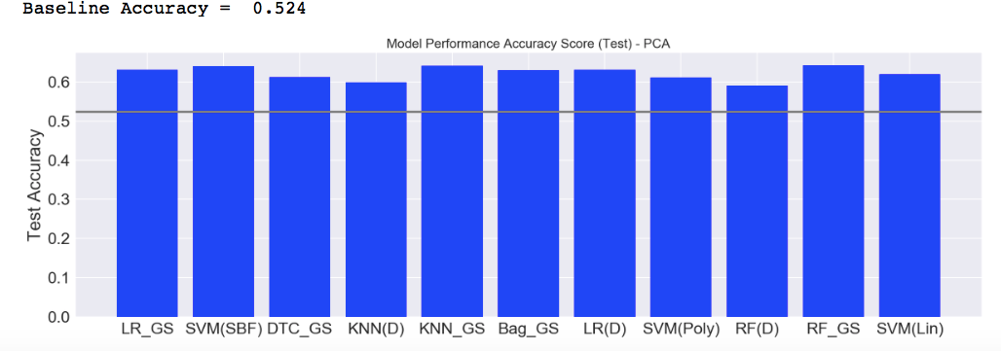
Classification
All Variables
PCA

Slide 14
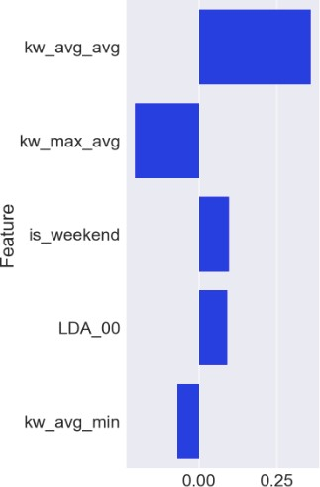
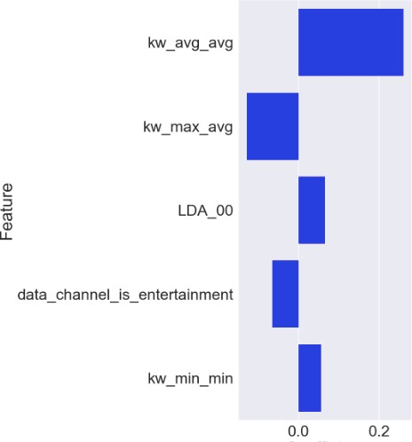
TOP 5 predictors related to size of news and article content
Most importance/Predictive Features
All Variables Random Forest PCA
(Optimal parameters)
Logistic Regression using recursive elimination (RFECV)

Slide 15
NLP: Predicting with the article content
Web Scraping / URL s columns
Features extracted from the TITLE (TF-IDF), plus filtering using Select K best
Features extracted from the BODY (TF-IDF), plus filtering using Select K best
Modelling : Naive Bayes classifier
Sentimental Analysis in order to find any insights relative to the content that appear in the title
Based on 2000 articles of the news

Slide 16
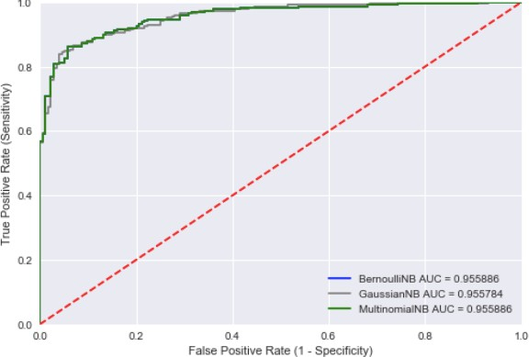
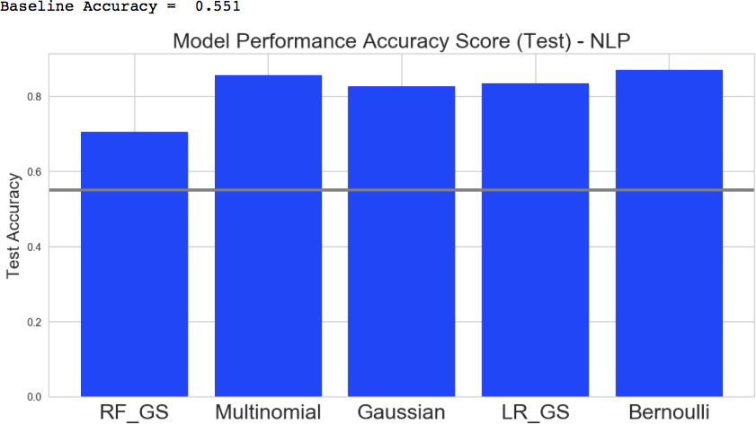
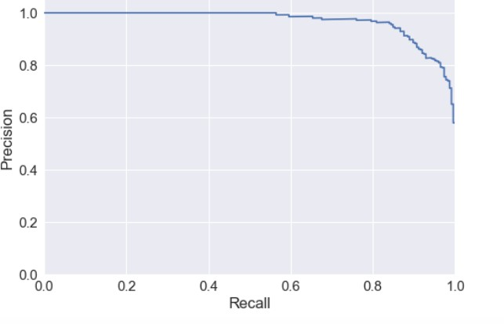
Accuracy score almost 90% - Bernoulli Model
ROC CURVES FOR BAYESIAN MODELS
NLP: Predicting with the
article content
0.87
RRECISION-RECALL CURVE BERNOULLI

Slide 17

Let us what is happening with the title

Slide 18
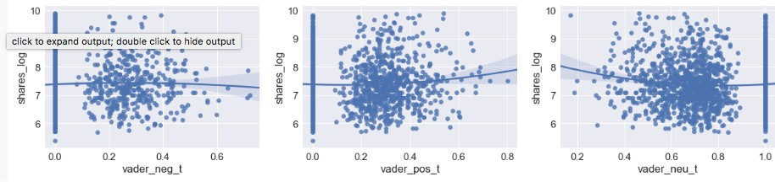
There is a positive correlation between social shares news and score positive in the title
NLP: sentimenal analisis
Score negative
Score positive
Score neutro
Based on 2000 articles of the news

Slide 19
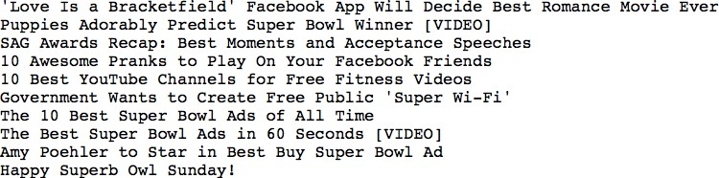
Top 3 titles are including start with a digital numeral y two of them have video
Positive words, strong visual and individual digit in title
Create THE BIGGEST IMPACT to share Top 10 titles with positive score
Based on 2000 articles of the news

Slide 20
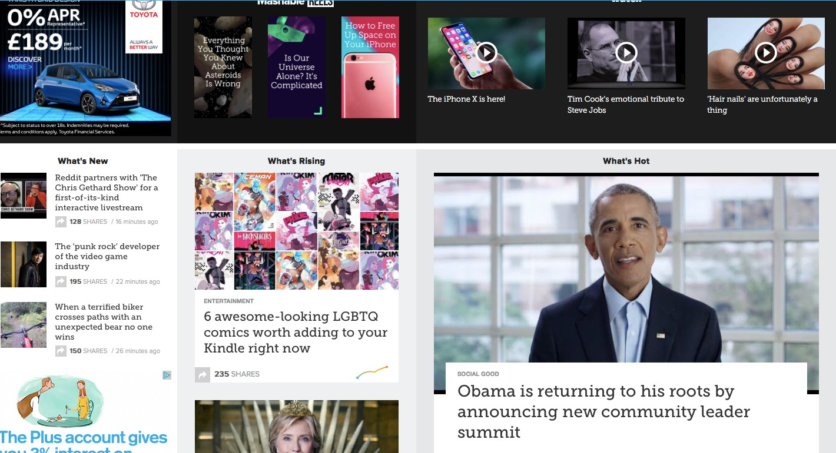
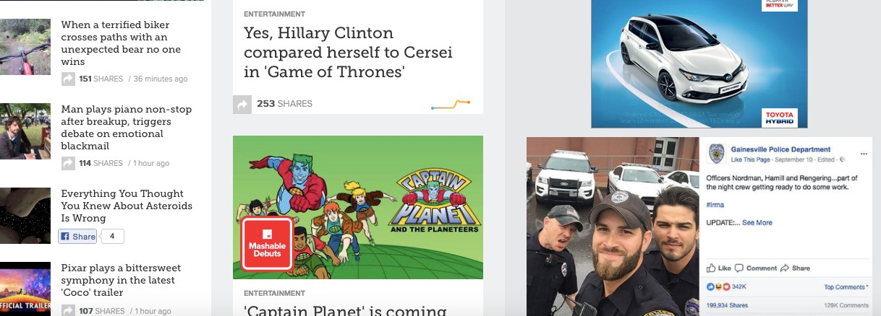
Title:
▪
▪
Strong visual
Start with a digital numeral
Start with positive imperative
▪

Slide 21
Specific keywords may be more informative and tech
What words were Hot in titles

Slide 22
Conclusion: Predicting the popularity of online news
Recommendations
Consideration the amount of the key words
TITLE : Positive words, strong visual and digital numeral
Articles of World and Entertainment
Referenced articles in Mashable
Methodology
The models provided here demonstrate that utilizing a two-class label system with a partition at the median provides the best models and including analysis the article content.
For future works, I would like to carry out in-depth NLP and Text Analysis.

